Slide 1
Building Cities for All
Training Program
1
Module 1
Disability Rights & Justice
Notes:
About the Global Network on DIAUD
The Global Network on Disability Inclusive and Accessible Urban Development (DIAUD) is a
multi-stakeholder network that works to ensure that the New Urban Agenda and the UN Habitat
III process incorporate the perspectives of persons with disabilities. The DIAUD network aims to
build and enhance networking among persons with disabilities and disability rights advocates;
policymakers and government officials; urban development professionals; academia; foundations;
the private sector; and development cooperation partners.
Established in partnership with the United Nations Department of Economic and Social Affairs /
Division of Social Policy and Development / Secretariat for the Convention on the Rights of
Persons with Disabilities, the DIAUD Network enables concerted disability-inclusive efforts to
contribute to Habitat III through its multi-stakeholder partners working on both disability and
urban development issues.
The DIAUD Network is supported by the Disability Inclusive Development (DID) Policy
Collaboratory, an initiative of the Institute on Disability and Public Policy at American University
and supported by The Nippon Foundation.

Slide 2
1.1
Understanding Disability
Rights & Justice
In this lesson, we will explore the important relationship between justice and disability. We will discover how the way we define disability fundamentally alters what it means to be a citizen as well as people’s freedom to work, travel, and interact with their environment.

Slide 3
Essential Question
When viewing the video, focus on answering the following questions:
What does justice have to do with disability?
Why is the charity model potentially harmful to persons with disabilities?
How the modern views of disability began to take shape around the world?
Notes:
i

Slide 4
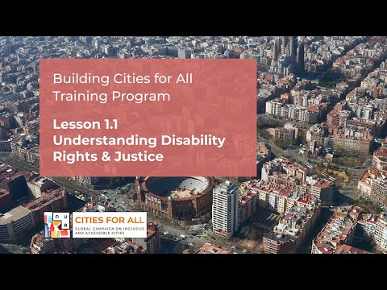

Slide 5
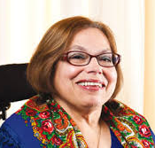
1.2
The Lived Experience with Judy Heumann
1.2
Judith Heumann is a globally recognized disability rights advocate and champion for civil rights. Her experience of having a disability and the challenges that she has overcome provide a first-hand account of how disability relates to justice and human rights.
Judith is featured in the film Crip Camp. Crip Camp is the story of one group of people and captures one moment in time. There are hundreds of other equally important stories from the disability rights movement that have not yet received adequate attention. Learn more at https://cripcamp.com/

Slide 6
When viewing the video, focus on answering the following questions:
Are persons with disabilities different from other people in society, if so how?
How have laws and standards changed the lived experience of persons with disabilities?
How does this experience affect identities, lifestyles, and preferences?
Essential Question
Notes:
i

Slide 7
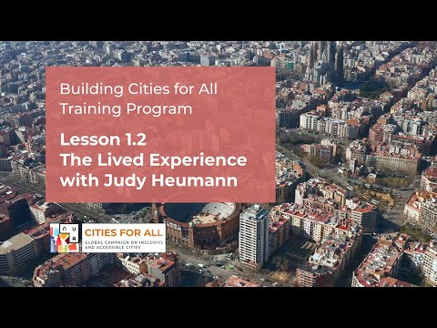

Slide 8
1.3
Deep Dive on Disability Rights and Justice
This module has been designed to explore in greater detail the most important concepts surrounding disability. These include disability justice, diversity, and the various models of disability that exist, and the effect they have on people’s lives.
These concepts are useful to students, decision-makers, urban practitioners, politicians, and government employees in gaining a more complete understanding of the principles that affect the inclusion and accessibility of persons with disabilities. They also play an important role in formulating, implementing, and evaluating the urban policies, plans, and programs that shape the accessibility of our cities.

Slide 9
As you move through this module, consider the following questions:
What are the three main models of disability and how do they differ?
What global agreements exist on disability and accessibility and what effect have they had?
What does it mean that disability is multidimensional? How might this affect persons with disabilities living in different countries around the world?
Essential Question
Notes:
i

Slide 10
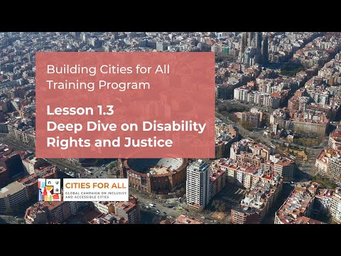

Slide 11
How disability justice helps remove barriers
Promoting disability justice protects the rights of persons with disabilities as full members of society. This is achieved by helping to create inclusive societies that ensure the full participation of persons with disabilities in all basic services that are available to the general population.
Disability justice involves the removal of barriers. These can be in the form of physical, attitudinal, legal, regulatory, or policy barriers and can also simply be a lack of information being available in accessible formats. No matter what form they take, these barriers prevent people from being able to fully participate. Promoting equality of opportunities and access to services and information for persons with disabilities is also critical to strategies for reducing poverty and the effective realization of the Sustainable Development Goals (SDGs) and the shared objectives of the international community.
Resources: Reporting on Disability - Guidelines for the media by ILO
Notes:
i

Slide 12
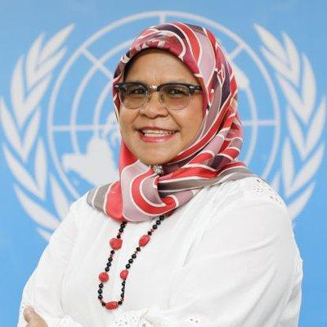
Models of disability what’s the problem, where’s the problem?
The model through which disability is viewed and interpreted can completely rewrite the script on how disability is perceived in society. And this in turn can completely transform the lived experience of persons with disabilities. In recent history, there have been three predominant models under which disability has been framed - the charity model, the medical model, and the social model.
“We need to create a greater level of livability and embed inclusivity to ensure that everyone has equal access to housing and public spaces. We need to put people before profit.”
Maimunah Mohd Sharif
Under Secretary General, UN Executive Director, UN-HABITAT
Notes:
i

Slide 13
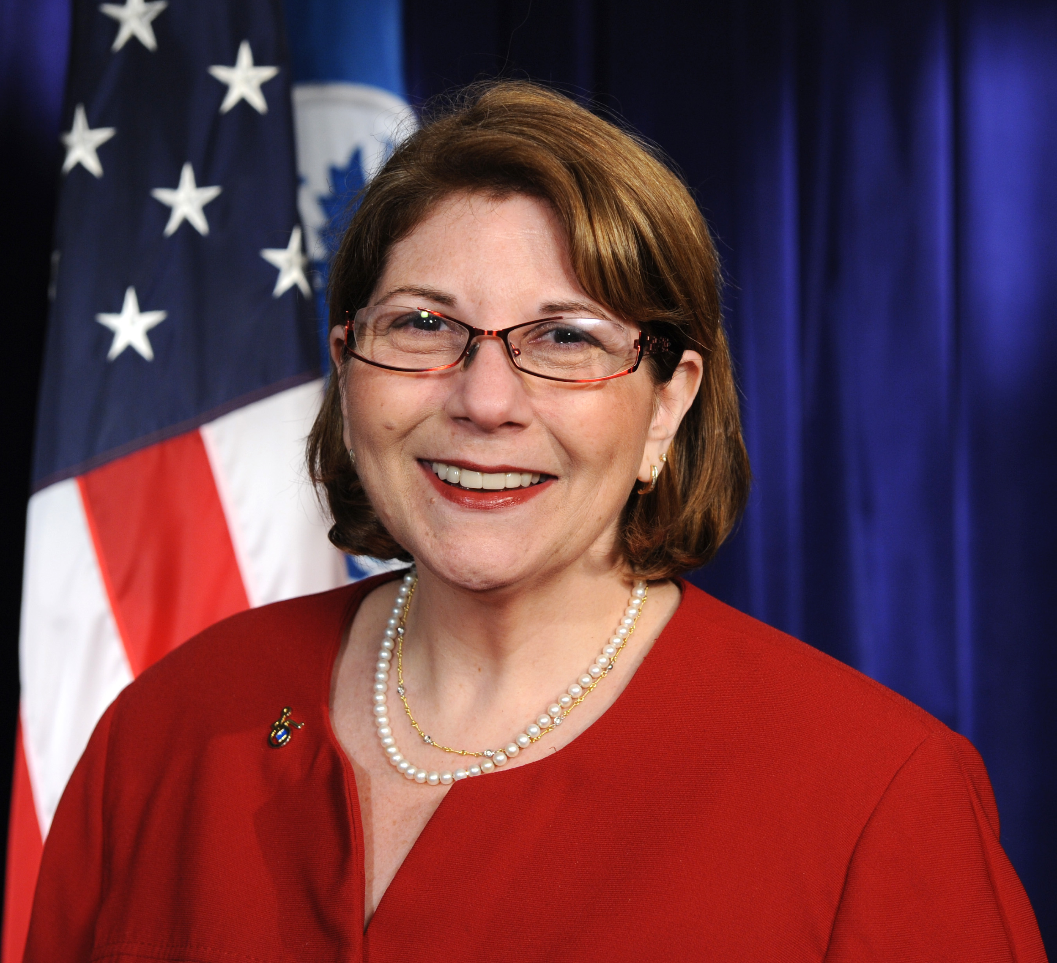
Charity Model
The charity model considers persons with disabilities as victims of circumstance and therefore deserving of sympathy and pity. Under this model, persons with disabilities are generally denied the opportunity or means to live independent lives. The model is condemned by its critics as dis-enabling and the cause of much discrimination.
“It is time to stop allowing ourselves to be characterized as vulnerable. As liabilities in emergencies and disasters. Vulnerability is due to failures in providing accessibility in the built environment, failures in providing effective communications access, and failures in emergency and disaster programs.”
Marcie Roth,
CEO of World Institute on Disability, Former Director for Disability, Federal Emergency Management Administration (FEMA)
”
Notes:
i

Slide 14
Medical Model
The medical model considers disability a problem inherent to the individual that is directly caused by a disease, an injury, or some other health condition that requires medical care in the form of treatment and rehabilitation. It assumes that addressing the medical ailment or impairment will solve the ‘problem’ – that disability needs to be fixed or cured.
This model does not see disability as a barrier between society or the physical environment and often overlooks the abilities of the disabled person. The model is widely criticised on different grounds, including not considering the important roles of environmental and social barriers.
Notes:
i

Slide 15
Social or Human Rights Model
The social or human rights model was developed as a reaction to the individualistic approaches of the charitable and medical models. It is human rights driven and socially constructed. It sees disability as created by the social environment, which excludes people with impairments from full participation in society as a result of attitudinal, environmental, or institutional barriers.
The social/human rights model sees the barriers to participation arising from the way a society is built and organized, and attitudes and mistaken assumptions about persons with a disability. The social model places emphasis on society adapting to include persons with disabilities by changing attitudes, practices, and policies to remove barriers to participation, but also acknowledges the role of health professionals and medical interventions and treatments.
While the model is a vast improvement over the charity and medical models, it is sometimes criticized for ignoring the personal impact of disability as well as for a perceived emphasis on individual empowerment, which may be contrary to more collective social customs and practices in many developing countries.
Notes:
i

Slide 16
Modern views on disability
Over the past decades, there has been a dramatic shift in how disability is perceived as persons with disabilities have started to be viewed as rights holders. Medical and charity models of disability have led to the development of interventions based largely on impairment needs. These are assessed by “expert” personnel, involving specialist services that are often severely limited as well as generally being expensive to run.
By contrast, the social or human rights-based approach recognizes disability as an important dimension of human diversity and affirms that all people, regardless of any impairment, have certain inalienable rights, i.e., civil and political as well as economic, social, and cultural rights, which include labor rights.
Notes:
i

Slide 17
The inclusion and diversity revolution
In the social/human rights model, people are disabled by attitudes and environments that discriminate against them. They may have impairments of various kinds – such as sensory, language, learning, or mobility impairments – but how disabled or enabled they are is a result of how society responds.
For example, a person may be strongly myopic (short-sighted), which is a relatively minor but still significant visual impairment. Are they disabled? No, society has made it easy for them to adjust; their glasses are affordable and readily available. Were this not so, driving, watching television, catching a bus, going to the cinema, or even identifying people in the street would be a challenge. They would, to a degree, be disabled. So do they “have a disability”? No. In this way, disability can be seen to be relational, not intrinsic. It depends on how society responds to the impairment.
Notes:
i

Slide 18
The inclusion and diversity revolution
People with various impairments are not intrinsically disabled. It is the medical model of talking about them, which conflates impairment with disability, that construes it this way by placing the disability with the person, not with society’s response to him or her.
Why does this matter? Because it tends to have the insidious effect of letting society off the hook; renouncing our responsibility to ensure equal rights and opportunities for everyone. The social/rights model of disability is one of the cornerstones of disability justice and equality!
Notes:
i

Slide 19
Global agreements on disability
The UN Convention on the Rights of Persons with Disabilities (UNCRPD) was established in 2008 and promotes the principles of accessibility and regulates obligations on the part of various national governments who have ratified the convention. As of July 2020, over 181 States, in addition to the European Union have signed on to the UNCRPD.
The UNCRPD was developed because persons with disabilities were continuing to be denied their human rights and were kept on the margins of society all around the world. The Convention sets out the legal obligations on States to promote and protect the rights of persons with disabilities. It does not create new rights. It is both a development and a human rights instrument, which is cross-disability and cross-sectoral. It is legally binding.
Notes:
i

Slide 20
Global agreements on disability
The UNCRPD has eight guiding principles that underscore the spirit of the agreement:
Respect for inherent dignity, individual autonomy including the freedom to make one’s own choices, and independence of persons
Non-discrimination
Full and effective participation and inclusion in society
Respect for difference and acceptance of persons with disabilities as part of human diversity and humanity
Equality of opportunity
Accessibility
Equality between men and women
Respect for the evolving capacities of children with disabilities and respect for the right of children with disabilities to preserve their identities
Notes:
i

Slide 21
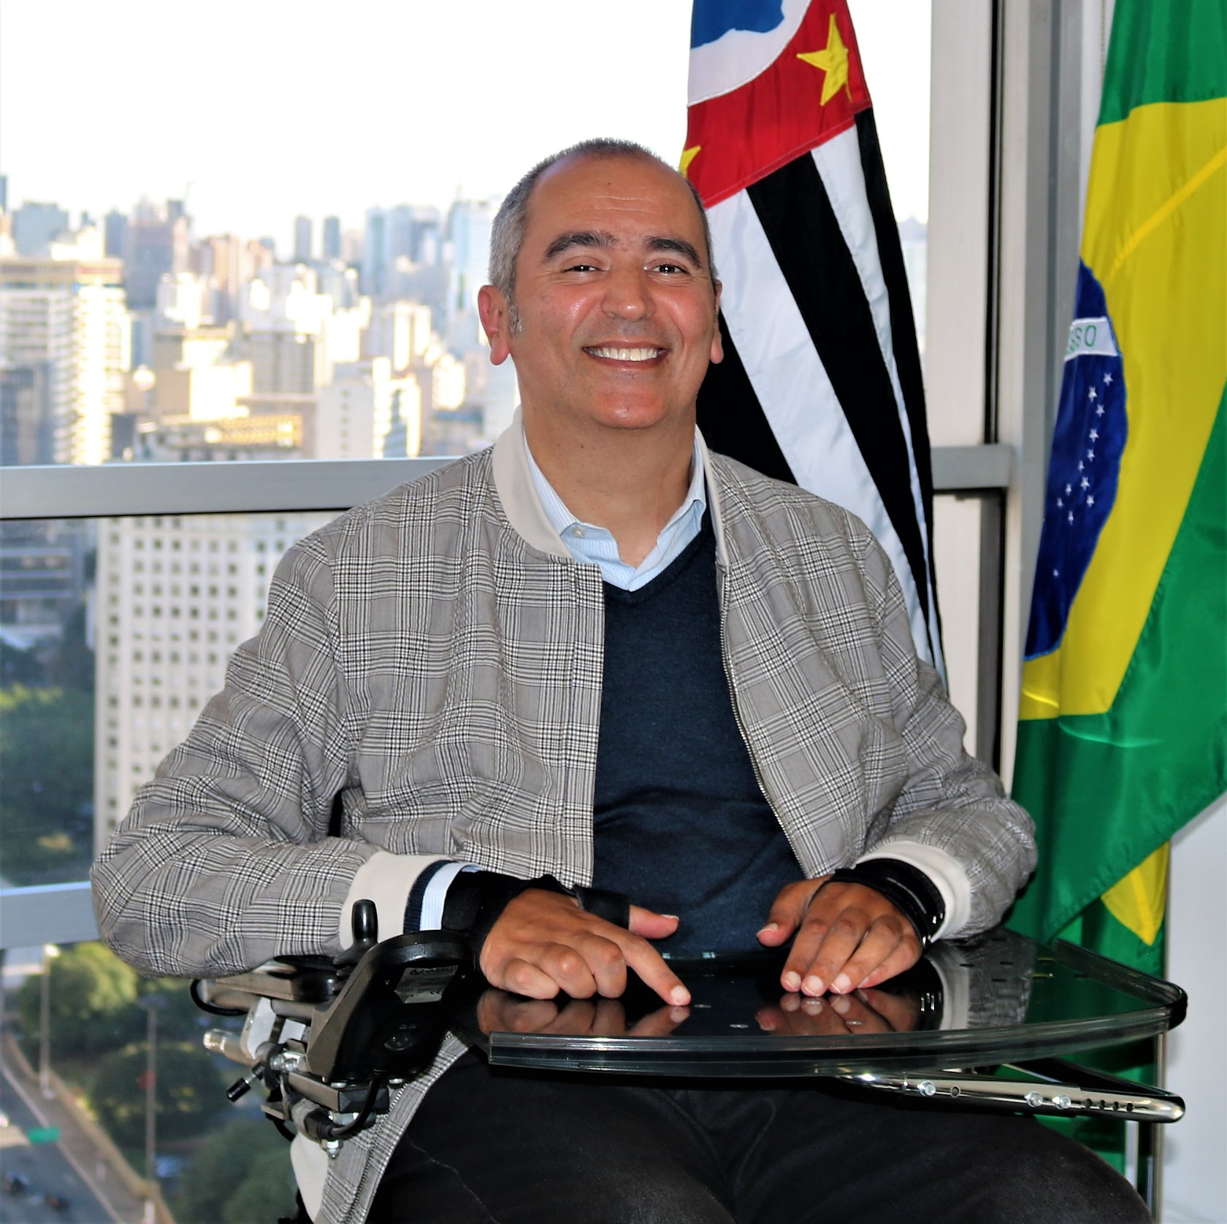
Global agreements on disability
The Convention marked a paradigm shift in attitudes and approaches to persons with disabilities. It established that persons with disabilities should not be viewed as “objects” of charity, medical treatment, and social protection. Instead, they should be seen as “subjects” with rights, who are capable of claiming those rights and making decisions for their lives based on their free and informed consent as well as being active members of society.
“Persons with disabilities are protagonists for new paradigms of inclusion, accessibility, human diversity, and transversal public policies. These agreements provide a new model of how persons with disabilities have to be treated.”
Cid Torquato
Municipal Secretary of Persons with Disabilities from the City of Sao Paulo
Notes:
i

Slide 22
Global agreements on disability
The UNCRPD has a stand-alone article on Accessibility – Article 9, as well as a number of other provisions on detailed guidance on measures that States shall take to advance accessibility. These include Article 19 on living independently and being included in the community, Article 20 on personal mobility, and Article 21 on freedom of expression and access to information.
People with disabilities have the same needs as non-disabled people to access education, employment, health, and well-being, for economic and social security, to learn and develop skills, and to live in their communities. To the greatest extent possible, these needs must be met within existing mainstream programs and services, not in specialized or segregated settings.
Notes:
i

Slide 23
Haben Girma accessibility and overcoming barriers
Haben Girma - accessibility and overcoming barriers
Haben Girma is an award-winning author and attorney. She was the first deaf-blind student to graduate from Harvard Law School. Her work as an accessibility advocate was recognized by President Barack Obama. Haben also surfs, dances salsa, and travels around the world. She wants to live in a world where her feats aren’t heroic, but normal. As you watch the video, pay attention to how she moves and communicates with the aid of devices, interpreters, assistants, and a service animal.
Notes:
i

Slide 24
1.4
Resources for advanced learning
This Lesson provides further detailed information and resources for readers looking to expand their knowledge of inclusive public policies.
Social inclusion covers a range of policies aimed at promoting equal opportunities, maintaining social cohesion, building social capital, and minimizing social exclusion. It is more than an ideological goal - it has to lead to inclusive policies and practices that promote disability-inclusive development.

Slide 25
Public policy - is the body of principles that underpin the operation of legal systems in a state that address the social, moral, and economic values that tie a society together.
Law & Public Policy
Law - regulates behavior either to reinforce existing social expectations or to encourage constructive change. Laws are most likely to be effective when they are consistent with the most generally accepted societal norms and reflect the collective morality of society.
Notes:
i

Slide 26
International bodies - such as the United Nations (UN), international standardization organizations such as the International Organization for Standardization (ISO) or the World Wide Web Consortium (W3C), are also involved setting standards and shaping policy.
Since many businesses are involved in operations across different countries, these international bodies often set the standard that specific countries follow, such as the UN Convention on the Rights of Persons with Disabilities (UNCRPD).
International
bodies
Notes:
i

Slide 27
Inclusive public policies
Inclusive public policies must promote:
Disability inclusive policy - mainstreaming disability in public policy
Inclusive planning, monitoring, and evaluation
Inclusive human resource management
Inclusive programs
Advocacy on the rights of persons with disabilities
Building capacity in accessibility and inclusion
The following links will help you go deeper and learn more about disability rights and justice. We hope you enjoy these and sharing these resources with your networks.
Notes:
i

Slide 28
Disability and the rights of persons with disabilities
It’s About Ability- UNICEF publication- An explanation of the Convention on the Rights of Persons with Disabilities
Mainstreaming disability in the post-2015 development agenda
Including the rights of persons with disabilities in United Nations programming at the country level
Reporting on Disability Guidelines for the media
Business as unusual: Making workplaces inclusive of people with disabilities
Decent work for persons with disabilities: promoting rights in the global development agenda
Promoting diversity and inclusion through workplace adjustments: a practical guide
WHO World Report on Disability (2011)
UCLG Policy Paper on Inclusive & Accessible Cities (2019)
The Inclusion Imperative – An Action-Oriented Guidebook for City Leaders and Advocates
Resources

Slide 29
International frameworks on disability
Status of Ratifications to the CRPD and Ratifications and Signatures of the CRPD and Optional Protocol
Full text of the UNCRPD
Conference of States parties
Committee on the Rights of Persons with Disabilities
Presidents’ Council on Disability Inclusion in Philanthropy
Infographic on the CRPD and the COSP
The Convention in Brief
Guiding Principles of the Convention
Entry into Force
Monitoring of Implementation
Powerpoint presentation
Resources

Slide 30
International frameworks on disability
Status of Ratifications to the CRPD and Ratifications and Signatures of the CRPD and Optional Protocol
Full text of the UNCRPD
Conference of States parties
Committee on the Rights of Persons with Disabilities
Presidents’ Council on Disability Inclusion in Philanthropy
Infographic on the CRPD and the COSP
The Convention in Brief
Guiding Principles of the Convention
Entry into Force
Monitoring of Implementation
Powerpoint presentation
Resources

Slide 31
Media and communications
Disability Rights Education Defense Fund: Doing Disability Justice
Disability and the Media: Promoting an accurate image and enhancing the voice of persons with disabilities in the media
Changing Attitudes Changing the World: Media’s Portrayal of People with Intellectual Disabilities
Guidelines: How to Write and Report About People with Disabilities
Creature Discomforts by Leonard Cheshire Disability
Eliminating Offensive Terms about People With Disabilities (Style guide and Terms To Avoid When Writing About Disability)
Media Representation of Disabled People
Resources

Slide 32
Human rights and disability rights
Civil and Political Rights
Learning about human rights and disability
Relationship between Development and Human Rights
The current use and future potential of United Nations human rights instruments in the context of disability by the United Nations, 2002)
Human Rights of Persons with Disabilities in Europe and the Commonwealth of Independent States: Guide, Monjurul Kabir, and Arkadi Toritsyn. UNDP, 2013.
Human Rights. YES! Action and Advocacy on the Rights of Persons with Disabilities
Training Manual on the Human Rights of Persons with Disabilities
Report of the UNHCR for Human Rights on progress in the implementation of the recommendations contained in the study on the human rights of persons with disabilities
Human rights and disability by Handicap International
The human rights-based approach to relief and development by Handicap International
We Have Human Rights: A human rights handbook for people with developmental disabilities by Harvard Project on Disability, 2008
Reporting on Disability - Guidelines for the media by ILO
GSDRC Topic Guide on Disability inclusion for Development Practitioners
Resources
You may consider sharing more resources with us on learning@worldenabled.org

Slide 33
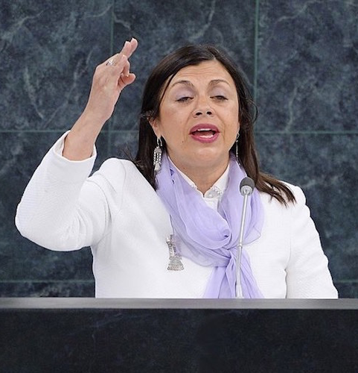
City Best Practices
Perspectives from Latin America
There are more than 85 million PWDs in Latin America (LA), of which half are over the age of 60. Existing problems with inequality across LA are being reinforced by the COVID-19 pandemic.
This pandemic has resulted in major socioeconomic impacts and inequalities in LA. The crisis has highlighted the need to be able to maintain continuity of service provision.
There is also lack of accessible information and more than 85 percent of PWDs are not aware of the programs that are available to them.
Prolonged periods of quarantine also expose many of society’s most vulnerable to increased rates of physical or sexual violence.
“What is needed in the face of this pandemic is an unprecedented response, an inclusive response. One that is dependent on an iron political will.”
María Soledad Cisternas - UN Special Envoy

Slide 34
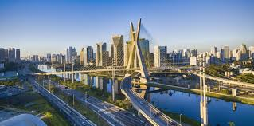
Emerging Trends
Perspectives from Latin America
Governments in Latin America need to ensure a rights based approach is used. Measures must include:
Promote resilience and equality of cities
Prioritize actions that protect the population living on the streets, the elderly and PWDs
Guarantee access to the internet, to various information channels/platforms and violence reporting lines
Guarantee medical and health services to those who need them most
Strengthen financial support, social assistance, and food assistance programs for the most vulnerable
Promote compliance with the SDGs that ensure the rights of people in developing countries
Ensure the inclusion of persons with disabilities in the development Pandemic responses
“What is needed in the face of this pandemic is an unprecedented response, an inclusive response.
One that is dependent on an iron political will.”
María Soledad Cisternas UN Special Envoy on Accessibility

