Slide 1
Building Cities for All
Training Program
Introduction to the Learning Modules
Version: November 30, 2020
Notes:
About the Global Network on DIAUD
The Global Network on Disability Inclusive and Accessible Urban Development (DIAUD) is a
multi-stakeholder network that works to ensure that the New Urban Agenda and the UN Habitat
III process incorporate the perspectives of persons with disabilities. The DIAUD network aims to
build and enhance networking among persons with disabilities and disability rights advocates;
policymakers and government officials; urban development professionals; academia; foundations;
the private sector; and development cooperation partners.
Established in partnership with the United Nations Department of Economic and Social Affairs /
Division of Social Policy and Development / Secretariat for the Convention on the Rights of
Persons with Disabilities, the DIAUD Network enables concerted disability-inclusive efforts to
contribute to Habitat III through its multi-stakeholder partners working on both disability and
urban development issues.
The DIAUD Network is supported by the Disability Inclusive Development (DID) Policy
Collaboratory, an initiative of the Institute on Disability and Public Policy at American University
and supported by The Nippon Foundation.

Slide 2
Introduction to the Cities for All Learning Modules
An ever-increasing number of people around the world now live in cities. And cities shape virtually every aspect of global development, including the manner in which fundamental dignities and human rights are recognized, discussed and implemented. This rapid urbanization has provided opportunities for transformational change, moving at an accelerated pace to improve social inclusion, access to services, and livelihoods. Cities also play a vital role in engaging marginalized populations that might otherwise be at risk of exclusion.

Slide 3
But cities are also under immense pressure to make the most of these opportunities by ensuring that urban development is inclusive and responds to the rights of all persons, particularly persons with disabilities and older persons. Social exclusion, discrimination, marginalization, and insurmountable environmental, infrastructural, and attitudinal barriers pose significant challenges for building inclusive cities and providing equal access to all so that everyone can live long and prosperous lives in urban areas. To achieve this, we must seek to fully understand what disability is and how it affects people’s ability to engage and interact fully with the services and environments they need to access.
By the end of this introduction session, you will learn what disability is and isn’t and how the way we view it fundamentally affects the lives of billions of people around the world. You will have an appreciation that all members of society have the same basic human rights, which include civil, cultural, economic, political, and social rights.
Introduction

Slide 4
As you move through this Introduction section, consider the following questions:
Why is disability an evolving concept?
What is the relationship between disability and human diversity?
What are the different types of barriers that persons with disabilities face?
Essential questions

Slide 6
The way we describe and view disability has far-reaching effects on the nature of people’s human rights and access to their cities. It impacts people’s lived experience as well as their health, educational, and employment outcomes. It also affects the scale of the barriers people face that limit their full potential from being realized.
As cities grow and develop, they become the embodiment of society’s values at a certain point in time. The values we hold are reflected in the places we build and the manner we design and provide services to people living in cities.
So when we talk about disability, how many people are we talking about? The World Health Organization and World Bank report that there are more than 1 billion people on earth who live with a disability. This means that persons with disabilities could be considered the largest minority group in the world.
Understanding disability in the city

Slide 7
Fundamental concepts and definitions - understanding what disability means and how to be respectful by using the appropriate people-first language that is inclusive of people of all abilities.
The conceptualization of disability - learning how the conceptualization of disability has been transformed to promote disability rights and how it was adopted as a social instrument to safeguard the rights of persons with disabilities.
The lived experience - understanding the range of lived experiences of persons with disabilities and why all persons with disabilities have the right to live a life that includes the enjoyment of their rights and dignities free from discrimination.
Focal points

Slide 8
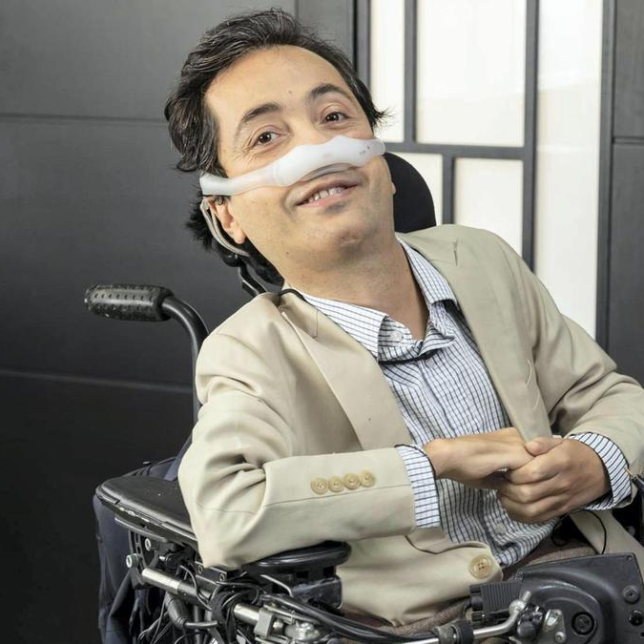
The term disability covers a wide range of different physical, psycho-social, sensory, or intellectual impairments that may or may not affect a person’s ability to carry out their day-to-day activities, including their jobs. In many parts of the world, persons with disabilities face obstacles, and barriers and are too often left out of public life. Because of this people from around the world have been working together with their governments and the United Nations to eliminate the obstacles and improve the lives of persons with disabilities.
Defining disability
“We all suffer when we are denied our fundamental freedoms, when we are denied choices, and when we aren’t given the chance to exercise our rights. Disability is a negative experience when we are deprived of our capabilities.”
Dr. Victor Santiago Pineda
Chairman of World Enabled Adj. Professor, University of California Berkeley

Slide 9
In the past, disability was defined using a medical model. Under that outdated model, disability was thought of as the property of an individual such that they had a physical deviation away from some perceived idea of “normal”.
By contrast, disability today is understood as something that results from the interaction between a person and their environment. This approach positions disability as an interactive and dynamic experience, or as Kat Holmes describes in her book, a “Mismatch.”
Defining disability

Slide 10
This can be clearly demonstrated by the following examples:
A person who uses a wheelchair might have difficulties gaining employment not because of the wheelchair, but because there are environmental barriers such as inaccessible buses or staircases that impede access to a place of work.
A person with extreme near-sightedness who does not have access to corrective lenses may not be able to perform daily tasks. This same person with prescription eyeglasses would be able to perform all tasks without any difficulty.
Defining disability

Slide 11
This guide will share many more examples and show that disability is an important part of our common human experience. It’s not abnormal, it is just a part of human diversity. Disability is part of the human condition. Everyone is likely to experience it, either permanently or temporarily, at some stage in their life. This is especially likely as we age.
Everyone should be treated equally and human diversity is part of human life. Everyone has differences and those differences should be accepted and valued.
Diversity is the reality so we should always be working towards making our society more inclusive of all people regardless of their individual characteristics.
Impairments brought about by aging can also create a mismatch. This mismatch oftentimes hinders the full and effective participation of older persons in society. This mismatch can affect the way we think, or the way our bodies work, our senses, our strength, stamina, and how we confront and navigate through the problems or barriers that arise from this mismatch.
Defining disability

Slide 12
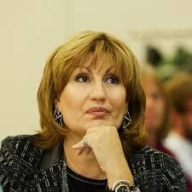
Persons with disabilities are diverse and are not defined by their disability. All people should have the opportunity to be able to access the environments and services of their city as well as be able to participate in civic life. Denying people these opportunities for access and inclusion creates barriers and is a form of oppression.
Building inclusive and accessible cities
“Let's be honest, our cities are not designed for everybody. They are not accessible and this has always been an issue. Now in light of this unprecedented pandemic, it is becoming even more painful. It is more critical than ever”.
Emilia Saiz
Secretary General, United Cities and Local Governments

Slide 13
Inclusion is not about inserting persons with disabilities into existing structures, but about transforming systems to be inclusive of everyone. Inclusive communities put into place measures to support all people with disabilities or older persons at home, school, vocational centers, sports, and cultural events and in their communities. When barriers exist, inclusive communities transform the way they are organized to meet the needs of all people.
Barriers create obstacles for individuals denying or diminishing their choices. These barriers can deny or diminish fundamental human rights, like political and public participation, employment, education, and other fundamental rights. Barriers further exclusion, isolation, disempowerment, and promote poverty, and inequality.
What is
inclusion all about?

Slide 14
Barriers hinder the full and effective participation of persons with disabilities in society on an equal basis with others.
How do barriers affect people's lives?
A lack of awareness and understanding about disability
Negative attitudes towards and stereotyping of persons with disabilities
Discrimination and the denial of fundamental rights and dignities
Attitudinal / social barriers

Slide 15
Lack of accessible buildings and green spaces such as parks
Lack of access to public transportation systems and infrastructure including buses, taxis, and planes
Lack of access to new technologies and innovations
Structural / physical barriers
Inadequate funding for disability services or for promoting accessible and inclusive systems and environments
Services that are not accessible or inclusive such as schools, health clinics, workplaces, and police or justice systems
Lack of adequate legislation, policies, and strategies for disability rights and inclusion
Limited choices for persons with disabilities and their communities
Limited opportunities for independence for persons with disabilities
Limited participation in decision making that directly affect the lives of persons with disabilities
Institutional barriers

Slide 16
How to use this learning guide
The intention of this learning guide is to educate and foster conversations around access and inclusion in cities and communities. It aims to address disability rights and justice including discrimination as well as solutions spanning all levels of the social, political, and personal spheres.
There are three modules that combine background information and discussion of key concepts surrounding disability as well as accompanying digital resources. Modules include essential questions, engagement with external videos, and the opportunity for advanced learning by accessing the listed additional resources. Video interviews feature Dr. Victor Pineda speaking with other experts on their lived experiences.
The Cities for All network includes a broad range of stakeholders including the United Nations, the public and private sectors, academia, and civil society organizations implementing the UN Sustainable Development Goals (SDGs). Partners can use these learning modules and tools licensed under creative commons as a “go-to” resource for their staff and stakeholders.

Slide 17
The videos and learning modules target a wide range of urban changemakers with a particular focus on changemakers who may also have disabilities. The content introduces access and inclusion as an important urban issue for policymakers and grassroots advocates.
The modules are written in simple language and will be universally accessible to persons with disabilities as well as high-school and college students who are learning about how best to contribute to building an inclusive society. They are also for city leaders who are accountable to the inhabitants of their city; social impact professionals working across philanthropy; innovators and think tank members; academics; policymakers; business professionals and entrepreneurs.
Audience

Slide 18
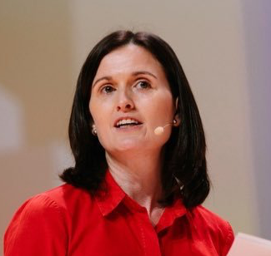
Emerging Trends
Perspectives from International Organizations
The effects of the COVID-19 pandemic have created many often sudden changes to the ways we carry out our lives. Some of the most important of these include:
Rapid adoption of remote working
Greater data privacy considerations posed by COVID-19 tracking apps
The increased risks posed by cyber attacks as security risks rise
Increased strain on digital infrastructure
Increasing usage of Internet of Things (IoT)
Acceleration in the adoption of automation and transition to virtual service delivery
Shift to participatory, virtual cultural experiences
Flourishing of open innovation
Isolation intensifying mental health challenges
Momentum towards a cashless economy
New financing needs and models
“As well as inclusion, we need to focus on creating cities that are good for our physical and our mental health. And that is required more than ever in the context of COVID-19.”
Alice Charles, Project Lead, Cities, Infrastructure and Urban Services Platform, World Economic Forum

Slide 19
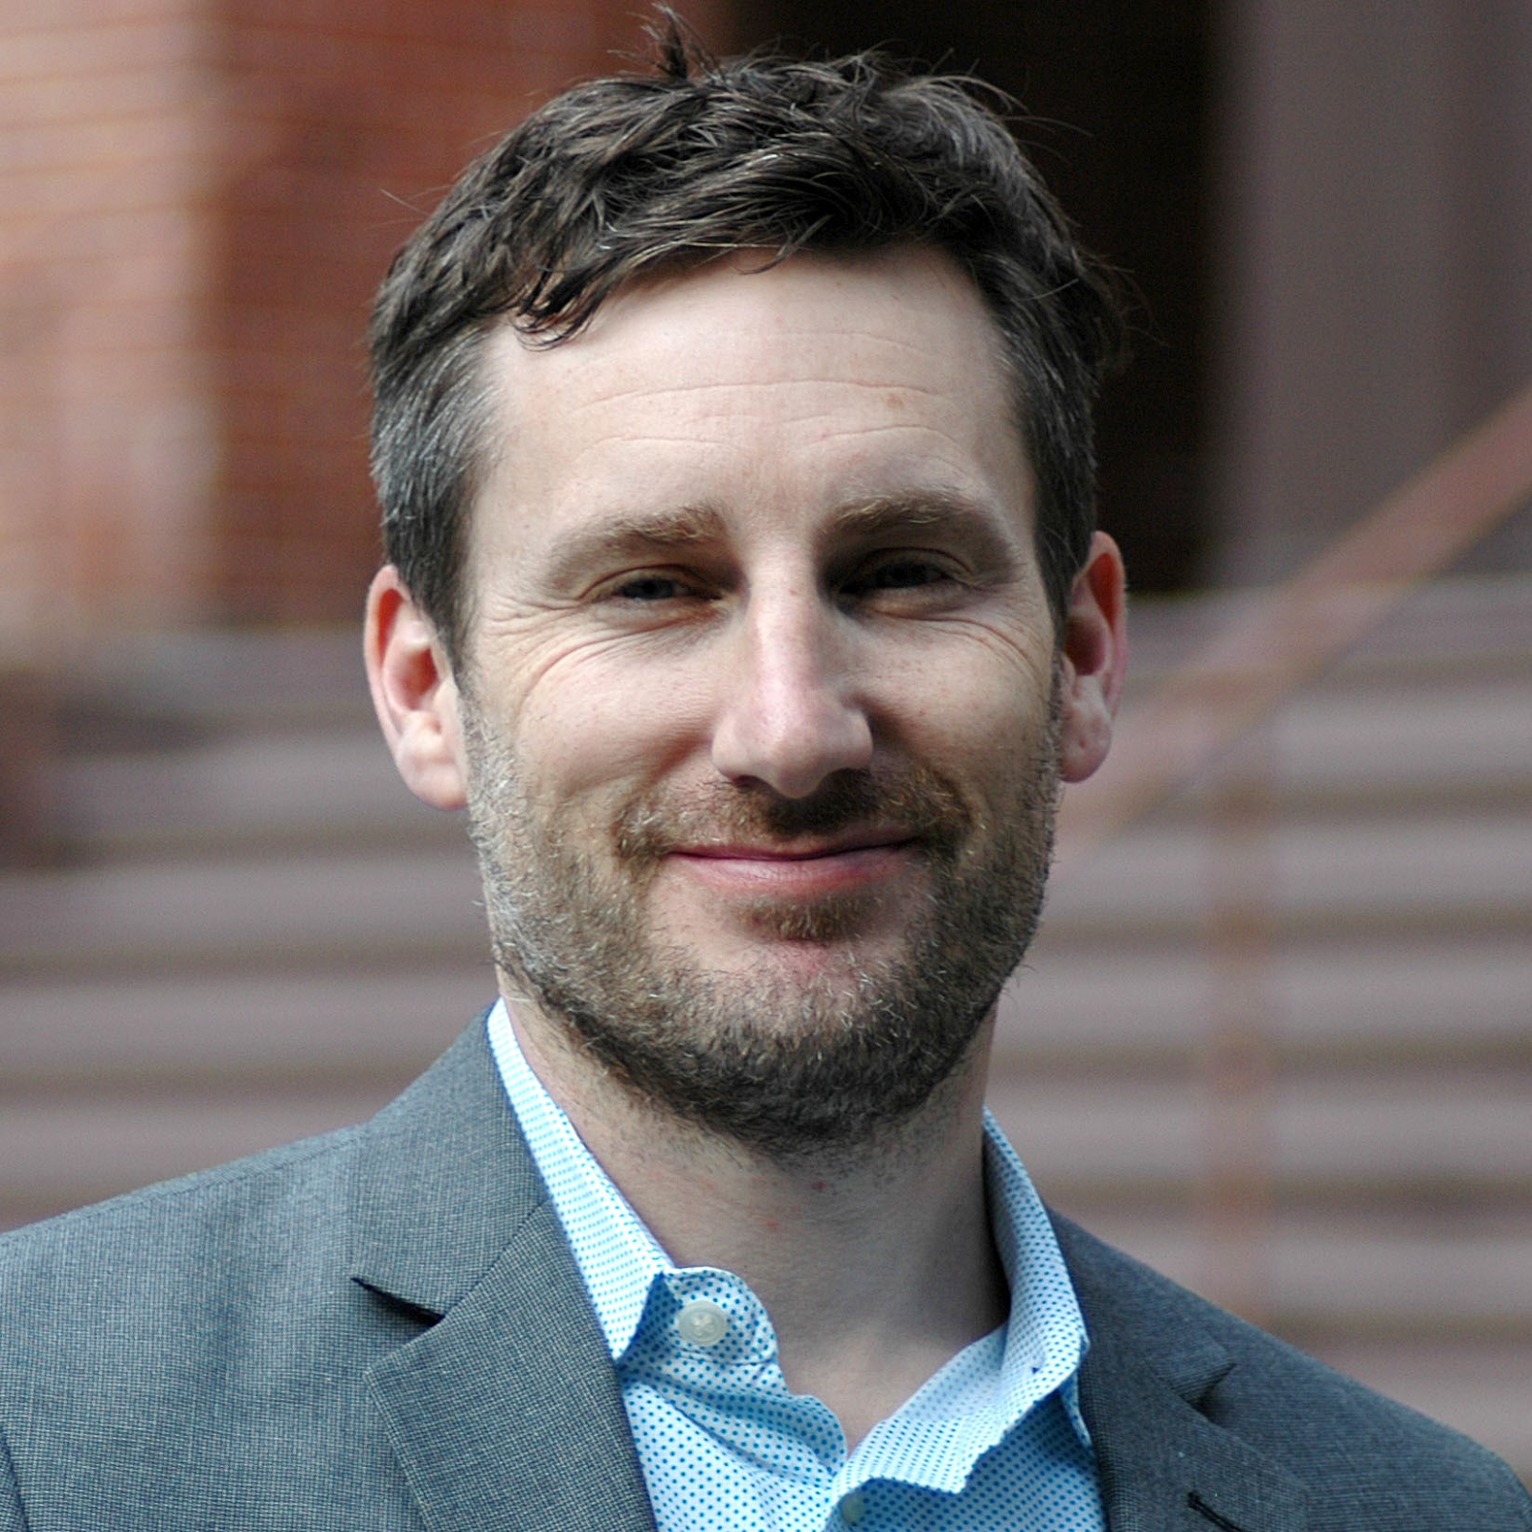
Emerging Trends
Perspectives from International Organizations
Each of these shifts provide clear risks as well as opportunities for cities and societies. These changes can have exaggerated impacts on at-risk people including people with disabilities or older people.
However, these new trends also provide the opportunity to use these changes as a way to alter the course of the greater transformations underway. The longer-term adaptations that society is forced to make to deal with the pandemic ultimately could result in greater equity and accessibility for all.
“The rapid growth of technology is currently being accelerated right now faster than at any point in time due to the current COVID-19 crisis. Accessibility is more important now than ever.”
Jeff Merritt, Head for IOT, Robotics, Smart Cities Center for the Fourth Industrial Revolution, World Economic Forum

