Slide 1
Building Cities for All
Training Program
2
Module 2 Non-Discrimination
Version: November 27, 2020
Notes:
About the Global Network on DIAUD
The Global Network on Disability Inclusive and Accessible Urban Development (DIAUD) is a
multi-stakeholder network that works to ensure that the New Urban Agenda and the UN Habitat
III process incorporate the perspectives of persons with disabilities. The DIAUD network aims to
build and enhance networking among persons with disabilities and disability rights advocates;
policymakers and government officials; urban development professionals; academia; foundations;
the private sector; and development cooperation partners.
Established in partnership with the United Nations Department of Economic and Social Affairs /
Division of Social Policy and Development / Secretariat for the Convention on the Rights of
Persons with Disabilities, the DIAUD Network enables concerted disability-inclusive efforts to
contribute to Habitat III through its multi-stakeholder partners working on both disability and
urban development issues.
The DIAUD Network is supported by the Disability Inclusive Development (DID) Policy
Collaboratory, an initiative of the Institute on Disability and Public Policy at American University
and supported by The Nippon Foundation.

Slide 2
2.1
Understanding Non-discrimination
At a basic level, we all have some idea of what discrimination is. But it’s important to understand what the wider effects of discrimination are. In this way, we are trying to not just understand what discrimination and what can be done to stop it.

Slide 3
When viewing the video, focus on answering the following questions:
What is discrimination and why does it occur?
What is ableism?
How do discrimination and other attitudinal barriers affect persons with disabilities?
Essential Questions

Slide 5
The Lived Experience with Abia Akram
2.2
In this section you will learn from the first hand experiences of disability rights advocate, Abia Akram. Abia is at the forefront of gender and disability advocacy in Pakistan and has expanded opportunities for women with disabilities in Pakistan and the greater Asia Pacific region.
Abia has always voiced the very strong message that you can't have gender rights without disability rights, and you can't have disability rights without gender rights. She talks a lot about her experience with discrimination and how we can protect women with disabilities from violence and abuse. Her leadership in Pakistan has dramatically changed the landscape and really put non-discrimination on the map throughout the Asia Pacific.

Slide 6
While listening to Abia speak, try to answer the following:
What type of discrimination do women with disabilities in some developing countries face?
What role does education play in discrimination?
What is the link between gender and disability rights?
Essential Questions

Slide 8
Learn more about Abia Akram
To find out more about the work being done by Abia, please refer to the following resources:
Abia Leads Work on Gender Equality
https://beijing20.unwomen.org/en/news-and-events/stories/2015/2/woa-pakistan-abia-akram
https://beijing20.unwomen.org/en/news-and-events/stories/2015/2/woa-pakistan-abia-akram
Abia Leads the Disabled Youth and Women’s Movements in Pakistan
https://35.chevening.org/changemakers/abia-akram/
http://www.sisofrida.org/abia-akram-campaigning-as-a-disabled-woman/
http://wd2016.org/speaker/abia-akram/
https://www.sightsavers.org/from-the-field/2018/09/eye-care-for-those-who-need-it-most/

Slide 9
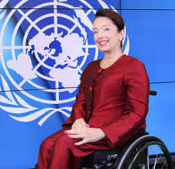
Deep Dive on Non-discrimination
2.3
Discriminatory practices against persons with disabilities can lead to the underutilization of their potential and limited or ineffective participation in society. Stigma and discrimination can adversely affect the dignity, confidence, and mental health of persons with disabilities.
“In 2020, the world has had to deal with the devastating impact of this pandemic. It is only when we engage all citizens, of all ages, and of all abilities, across all levels of government, academia, the private sector, and civil society organizations, that we can ensure an inclusive and participatory recovery.”
Daniela Bas
Director of the Division for Inclusive Social Development, the United Nations Department of Economic and Social Affairs (UN DESA)

Slide 10
As you move through this module, consider the following questions:
What are some of the primary causes of discrimination?
What are implicit biases?
What is disability mainstreaming and why is it important?
Essential Questions

Slide 12
Understanding ableism
An anti ableist society eliminates all forms of discrimination against persons with disabilities and provides an inclusive environment for their full participation in all affairs of society. It encourages participation of persons with disabilities in policy and decision making and works towards overcoming the barriers that persons with disabilities face in accessing physical environments, transportation services, health, rehabilitation, support, and assistance services as well as accessing education and employment opportunities.
Are there any rules or procedures within your community, educational, or working environment that create unnecessary difficulties for persons with disabilities? The answer is yes, to some degree. Thanks to the United Nations Convention on the Rights of Persons with Disabilities and the efforts of advocates, city leaders, and many others, we know that every community has been making some progress.
Later in the learning guide you’ll come across the stories of diverse individuals leading change in their cities and communities to create a more accessible future for all.

Slide 13
Understanding non- discrimination
The principle of non-discrimination seeks “to guarantee that human rights are exercised without discrimination of any kind based on race, color, sex, language, religion, political or viewpoints, national or social origin, property, birth or another status such as disability, age, marital and family status, sexual orientation and gender identity, health status, place of residence, economic and social situation”.
Source: Committee on Economic, Social and Cultural Rights, General Comment No. 20, Non-discrimination in economic, social and cultural rights; 2009

Slide 14
Understanding non- discrimination
Non-discrimination constitutes a basic and general principle relating to the protection of human rights of all persons. It is an indivisible part of international human rights law. Stigma and discrimination are among the main barriers that keep the majority of disabled women, men, and children living in poverty, dependence, and social exclusion.
As discussed in Module 1, a human rights-based approach to disability regards limitations imposed on persons with disabilities by social and physical environments as violations of their basic human rights. However, these rights are often violated due to ignorance and lack of information.

Slide 15
Implicit biases
How do we perceive and interpret ourselves and the world? We perceive and understand our lives and world uniquely, but we are pressured to fit into a role. This is part of the process of socialization.
Another side effect of socialization is that it tends to establish implicit biases. These reinforce stereotypes and influence our perceptions, judgments, decisions, and actions. Implicit bias is unconscious. It may even be different from your conscious belief system. Implicit biases about persons with disabilities are pervasive and can lead to discrimination due to unfair or prejudicial treatment of people and groups.

Slide 16
Implicit biases
Implicit biases develop over the course of a lifetime, beginning at an early age. They cause us to see and judge people’s traits as being more or less desirable, or judge them as being more or less valuable to society. Empirical studies show a dominant preference or bias towards non-disabled bodies, often eliciting sympathy and pity towards persons with disabilities or making the false assumption that they are unhappy or have a deep dissatisfaction with their life.
Policy makers are also prone to consistently assume, based on their biases, that persons with disabilities can all be grouped together. As a result, persons with disabilities tend to be overly represented by wheelchair users while underrepresented by persons with intellectual or invisible disabilities.

Slide 17
Implicit biases
Implicit biases develop over the course of a lifetime, beginning at an early age. They cause us to see and judge people’s traits as being more or less desirable, or judge them as being more or less valuable to society. Empirical studies show a dominant preference or bias towards non-disabled bodies, often eliciting sympathy and pity towards persons with disabilities or making the false assumption that they are unhappy or have a deep dissatisfaction with their life.
Policy makers are also prone to consistently assume, based on their biases, that persons with disabilities can all be grouped together. As a result, persons with disabilities tend to be overly represented by wheelchair users while underrepresented by persons with intellectual or invisible disabilities.

Slide 18
The importance of terminology
Being person-centered means that you will always see, respect, and respond to the individual person – not the abilities or impairments they may have or the labels they may have been given.
Truly inclusive spaces are not simply those that admit the widest range of people, but those that respond to the unique characteristics of each person. Get this right, and the language will tend to take care of itself.

Slide 19
Adopt people-first language - put the person first when referring to persons with disabilities such as “the boy with autism” versus “the autistic boy”
Understand and adopt the social or rights model of disability - we should not be trying to “cure” disabilities and instead should be trying to ensure the rights of all people.
Be person-
centered

Slide 20
Create a space in which people can express their wishes and the terms they prefer
Allow people to show their own strength, creativity, and purpose.
Be present and authentic
Be accepting

Slide 21
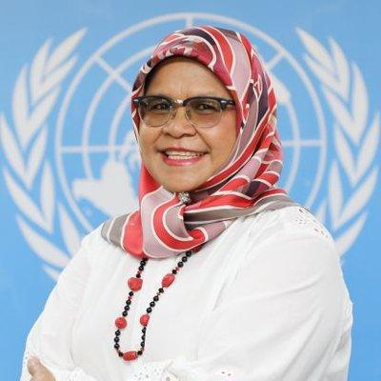
Removing barriers
Barriers hinder full and effective participation of persons with disabilities in society on an equal basis with others. Barriers can exist in a variety of forms.
“We need to revisit the way we plan cities because it is becoming clear that adhering to best practices helps cities become more resilient places. More importantly, we must ensure inclusivity is at the heart of how we manage cities”
Maimunah Mohd Sharif
Under Secretary General, UN Executive Director, UN-HABITAT

Slide 22
Lack of awareness and understanding
Negative attitudes, biases, and stigma
Discrimination
Attitudinal/social barriers
Environmental barriers
Lack of accessible buildings
Lack of accessible transport systems
Lack of accessible green spaces
Lack of accessible services in all sectors such as health, education, employment, police, and protection services
Lack of accessible communication systems including media, information services, mobile technologies, and apps.

Slide 23
Institutional barriers
Inadequate legislation, policies, and strategies
Limited opportunities to live independent lives
Limited participation in decision making
Inadequate funding
Attitudinal/social barriers
An Animated Story of Sarah
Why Disability Inclusion is Good For Everyone: An Animated Story of Sarah
https://www.youtube.com/watch?v=rjluLV1F-UI

Slide 24
Discrimination against persons with disabilities
Persons with disabilities are subject to multiple violations of their rights including to their dignity. These could be through denial of autonomy, acts of violence, abuse, prejudice, or disrespect because of their disability. Discrimination and oppression of persons with disability are the direct result of implicit biases and are shaped by our personal experiences, the attitudes of family and friends, living and working environments, culture, the media, books, and movies.
Social exclusion, discrimination, marginalization, and insurmountable environmental, infrastructural, and attitudinal barriers pose significant challenges to building safe, inclusive, and resilient cities. Discriminatory practices against persons with disabilities can impede the realization of the 2030 Agenda for Sustainable Development and other internationally agreed development goals. Discrimination also contributes to the disadvantages and marginalization faced by persons with disabilities, leading to disproportionate rates of poverty, deprivation, and exclusion.

Slide 25
Understanding ableism
Ableism is the social prejudice, discrimination, and oppression of persons with disabilities based on the belief that typical abilities are superior. It is based on societally constructed ideas of normalcy, intelligence, and excellence and that being abled is “normal” and preferred. Ableism is deeply rooted in various forms of marginalization and prejudice.
Source: Disability Philanthropy, https://disabilityphilanthropy.org/resource/what-is-ableism/

Slide 26
Understanding ableism
An anti ableist society eliminates all forms of discrimination against persons with disabilities and provides an inclusive environment for their full participation in all affairs of society. It encourages participation of persons with disabilities in policy and decision making and works towards overcoming the barriers that persons with disabilities face in accessing physical environments, transportation services, health, rehabilitation, support, and assistance services as well as accessing education and employment opportunities.
Are there any rules or procedures within your community, educational, or working environment that create unnecessary difficulties for persons with disabilities? The answer is yes, to some degree. Thanks to the United Nations Convention on the Rights of Persons with Disabilities and the efforts of advocates, city leaders, and many others, we know that every community has been making some progress.
Later in the learning guide you’ll come across the stories of diverse individuals leading change in their cities and communities to create a more accessible future for all.

Slide 27
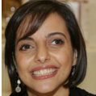
People have different needs and preferences
Everyone has the right to be free from discrimination on the basis of disability, and also on race, color, sex, language, religion, political views, national or social origin, property, birth or other status.
“We need to ensure that persons with disabilities are visible during humanitarian responses. Not discriminating extends beyond physical accessibility to communications access. We need a baseline of information that can be used to ensure people are not discriminated.”
Alia H. Zureikat,
Higher Council for the Affairs of Persons with Disabilities (HCD), Amman, Jordan

Slide 28
Misconceptions and stigma
Common misconceptions about persons with disabilities include:
They are unable to be independent
They do not contribute to society/family
They are unable to have normal relationships or are a burden
That disability is contagious or brings bad luck
Their bodies have magical powers
They are unable to report sexual abuse
https://www.dpa.org.sg/wp-content/uploads/2015/10/DPA-Disability-Glossary-FINAL.pdf
Stigma is a negative set of beliefs about people with specific characteristics (ethnicity, disability, age, gender, etc.). The main drivers of stigma include a lack of understanding and awareness, social avoidance, and stereotyping.

Slide 29
2.4
Resources for advanced learning
Disability mainstreaming is a method to promote inclusion and address barriers that exclude persons with disabilities from equal participation in society through the social/rights-based model. It is a process to ensure that persons with disabilities have choices and participate equally with others in any activity and service intended for the general public. This includes education, health, employment, safety/security, social services, sport/leisure, etc. Mainstreaming disability not only helps fulfill human rights, but it is also more effective (for more details refer to Accessibility & Development).
Disability mainstreaming enables disability-inclusive development in systems, strategies, policies, programs, and practices via:

Slide 30
Acceptance
The entire community, including persons with disabilities, benefit equally from policies and programs.
Equity
Participation
Social acceptance of persons with disabilities in all their diversity and empowering them to make their own choices.
Persons with disabilities participate in all policy, program development, and decision making.

Slide 31
Inclusive development is continuous and embedded in all policies, systems, practices, and culture.
Accessibility
Sustainability
Environmental, institutional, and attitudinal barriers are identified and addressed

Slide 32
International frameworks on disability
Achieving Equal Employment Opportunities for People with Disabilities through Legislation
Presidents’ Council on Disability Inclusion in Philanthropy
GSDRC Disability inclusion- Guide
Convention on the Rights of Persons with Disabilities (CRPD)
Factsheet UNCRPD
Best practices for including persons with disabilities in all aspects of development efforts
Mainstreaming Disability in the Development Agenda
Disability Dimension in Development Action: Manual on Inclusive Planning
Resources

Slide 33
International Framework
Keeping the Promise: Realizing MDGs for Persons with Disabilities Towards 2015 and Beyond: Report of the Secretary-General
Incheon Strategy to “Make the Right Real” for Persons with Disabilities in Asia and the Pacific
2030 Agenda Introductory Toolkit and Comprehensive Guide for persons with disabilities
UN DESA - UN ENABLE
UN ENABLE Policy & Action Plan in Disability Inclusion
EQUALITY & HUMAN RIGHTS COMMISSION UK
DisCo Policy Framework for Inclusive Urban Development by Dr. Victor Pineda.
Building the Inclusive City- Governance, Access, and the Urban Transformation of Dubai
Resources

Slide 34
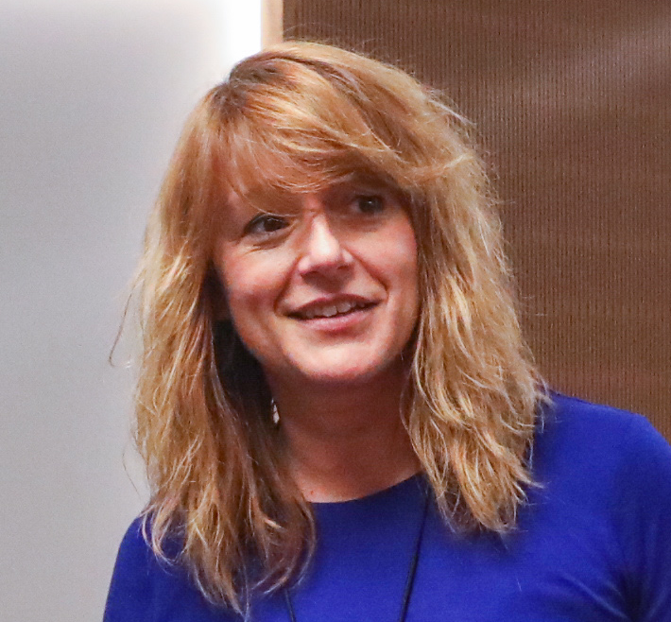
Examples from Local Governments - Europe
City Best Practices
Perspectives from Europe
Spain has a very high proportion of older people and digital technologies can play a key role in helping to address this as well as narrowing the digital divide.
VinclesBCN is a service of ​Barcelona City Council designed to strengthen the social relationships of vulnerable people. It has been in place since 2014 and is aimed at assisting elderly people living in the city of Barcelona and improving their well-being through technology and the support of social dynamization teams.
The VinclesBCN platform provides access to social and emotional services via a tablet and also features a training program in how to use the service. The city council provides the elderly who are users of the service with the tablet and the application pre-installed.
“It is our priority as a city government that the physical distancing in the context of lockdown does not have to become social distancing. We are striving to leave no one behind.”
Laia Bonet, Vice-mayor for City of Barcelona

Slide 35
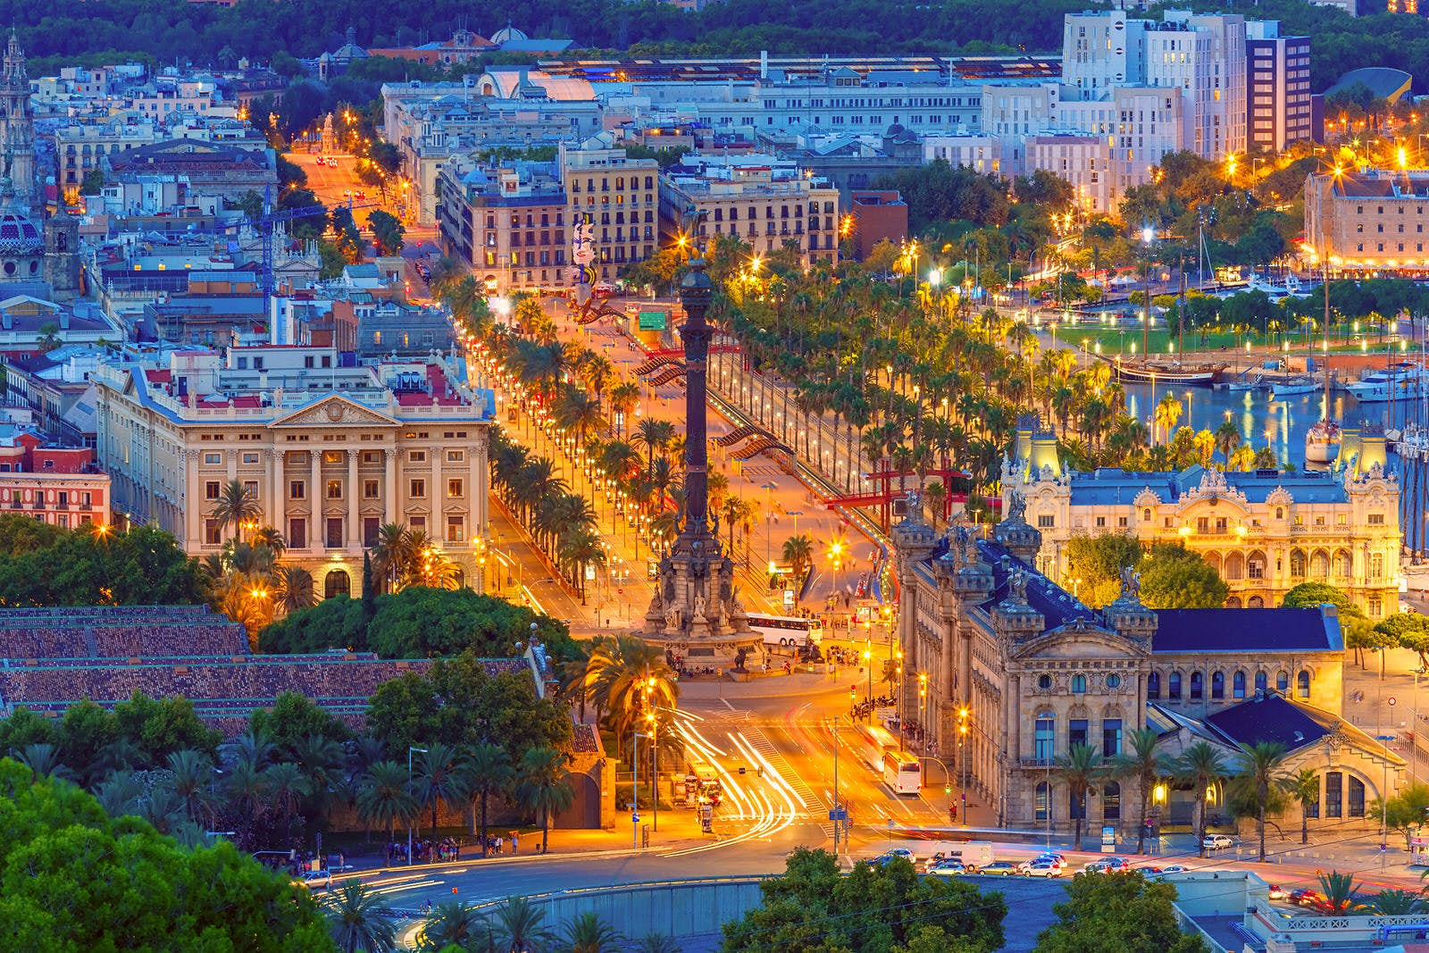
Examples from Local Governments - Europe
City Best Practices
Perspectives from Europe
At least one tablet has additionally been provided to all 296 nursing homes in Barcelona. To date, it has helped over 2,400 elderly people manage their relationships through digital technology.
The service includes a health channel that features a team of doctors and a nurse to provide reliable information via text or voice. People can chat with the health team for individual questions or via one of 21 information groups through which the health team passes on clear and accessible information.
There is also a virtual spiritual support component that has been created via partnerships with the Catholic Church, Islamic Federation, Jewish community, and Evangelical community.

