Slide 1
3
Building Cities for All
Training Program
Module 3 Understanding Accessibility
Version: November 30, 2020

Slide 2
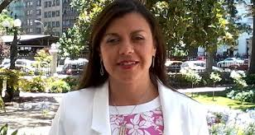
3.1
Understanding Accessibility
Accessibility is more than just about ramps. When accessibility is done right, people feel like they really belong in their city. In this section, we come to understand how to leverage accessibility to improve the urban environment, make a better app, products and services, or change people’s attitudes to create a more inclusive society.
“We must recognise that accessibility is the most mainstream legal strategy in the human rights field in the 21st century. It is a part of universal design. We therefore need to ensure that we provide persons with a disability the genuine opportunity to live independently.”
Maria Soledad Cisternas
UN Special Envoy on Disability and Accessibility

Slide 3
While watching the video, think about the following questions:
What are the basic concepts of accessibility and universal design?
How do standards improve the accessibility of cities and what are the consequences of non-compliance with standards?
How does making accessible products and services benefit organizations?
Essential
questions

Slide 5
3.2
The Lived Experience with Karen Tamley
In this section you will learn from the first hand experiences of Karen Tamley, who is a member of the U.S. Federal Access Board. She is President and CEO of Access Living, a community based center that provides resources and support for persons with disabilities in Chicago.
Karen Tamley has expanded opportunities for the residents of Chicago both as a city official running the Mayor’s Office for Persons with Disabilities and now as a non-profit executive. Having worked as a city official, she understands first hand how her work on accessibility and her lived experience as a person with a disability can change a city. Let's hear what she has to say.

Slide 6
While watching the video, think about the following questions:
How does the age of city infrastructure impact the accessibility of cities?
How has the COVID-19 pandemic influenced the lived experience of persons with disabilities?
How can decision making at the city or community level improve the situation for persons with disabilities?
Essential
questions

Slide 8
Learn more about Karen Tamley
To find out more about the work being done by Karen, please refer to the following resources:
Karen Leads Work on disability policy and accessibility initiatives
https://www.accessliving.org/newsroom/press-releases-and-statements/karen-tamley-access-livings-next-ceo-announcement/
https://www.newmobility.com/2013/07/karen-tamley-advocrat-wife-mother/
Karen as Chicago Disability Commissioner has led disability-related work in the areas of transportation, city infrastructure, technology, emergency planning, education and employment
https://www.govtech.com/top-25/2020/Karen-Tamley.html
https://www.youtube.com/watch?v=_m0njgFJzZs
https://medium.com/disability-power-and-influence/the-ada-at-29-6c0bdd98b709

Slide 9
3.3
Deep Dive on Accessibility
The accessibility of our cities is of paramount importance because disability is the one group that we will all be a part of if we live long enough. As we age, people become increasingly reliant on infrastructure and services that may for example have initially been designed for someone with a mobility or visual disability. Therefore what we ultimately should be looking for is excellence across all aspects of our urban environments. True accessibility is a race to the top.
This module presents the core ideas and definitions needed to understand in greater depth the various key accessibility concepts. It provides an understanding and practical examples of accessibility and how to build in features to ensure that persons with disabilities can enjoy real equality in society. It explores the principles of universal design and why accessibility solutions can be produced to respond to a wide-range of expected end-user needs, interests, and capabilities - for persons with disabilities and non-disabled persons alike.

Slide 10
While watching the video, think about the following questions:
How do accessibility principles help urban planning, not just persons with disabilities?
How does universal design differ from just creating great products?
What are the cost implications of universal design?
Essential questions

Slide 12
Understanding accessibility
Accessibility refers to a feature or quality of any physical or virtual environment, space, facility, or service that is capable of accommodating the needs of users of varying abilities or disabilities to understand, get access to, or interact with. Accessibility is critical for enabling persons with disabilities to gain access for equal opportunity and live independently and participate fully in all aspects of life in an inclusive society.
An accessible environment allows for free and safe movement, function and access for all, regardless of age, sex or condition. It is a space or a set of services that can be accessed by everyone - without obstacles, with dignity, and with as much autonomy as possible. Accessibility also refers to technical standards that are mandated nationally or internationally for the design and construction of a physical or virtual environment, space, facility, or service.

Slide 13
Types of accessibility
Accessibility of the built environment - this includes housing and private buildings, public spaces and buildings, as well as applies to the social environment that includes access to services and government offices. Technical standards like ISO 21542 help define the specific requirements.
Accessible transportation systems - this looks at the ability for people to move freely around their cities. Everybody should have the right and the opportunity to choose their means of transport, to go from one place to another according to their needs, abilities, and budget.
Access to information and communication technologies (ICT) - accessible media, websites, apps, accessible dissemination of information, and accessible outlets. Some examples of features of accessible ICT include using clear language, closed captions for video content, large or high contrast fonts, and easy to navigate user interfaces. Technical standards like ISO 40500 help define the specific requirements.

Slide 14
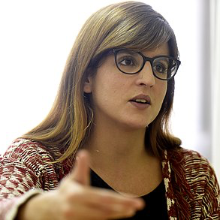
Types of accessibility
There are also various types of accessibility aspects that span the physical and information and communications technology environments (including hardware, software, information materials, and web accessibility) that might for example be related to an online transportation ticketing system.
“Accessibility is about ensuring a good way of life for all. There is much that can be learnt from the experiences of other cities so it is important that information is shared between city leaders from around the world.”
Fabiana Larisa Goyence Giupponi
Director of Social Dev.
Montevideo, Uruguay

Slide 15
Why accessibility matters in city planning
Many contemporary cities suffer from a lack of accessibility to basic urban services such as sanitation and water, health, education, transportation, emergency and disaster response, resilience building, and access to information and communications. These accessibility limitations greatly contribute to the disadvantages and marginalization faced by persons with disabilities, leading to disproportionate rates of poverty, deprivation, and exclusion. These disadvantages also impede the realization of the 2030 Agenda for Sustainable Development and other internationally agreed development goals.
Refer: World Enabled and CBM’s Easy Read Document on How to make cities accessible and inclusive

Slide 16
The principles of accessibility when applied to city planning support other government directives that encourage compact, pleasant, environmentally sustainable urban spaces with mixed-use residential and business nodes. They promote walking and cycling, as well as easy-to-use public transport for people who are unable to walk long distances.
Why accessibility matters in city planning
“When Hurricane Sandy hit New York City in 2012, it hit hard. There were accessibility issues with shelters, with communications, and issues around paying attention to persons with disabilities to the level that was needed. We addressed this by working with the community. The city wasn’t as prepared as it is today. ”
Victor Calise
Mayor’s Office for People with Disabilities, New York City

Slide 17
Why accessibility matters to persons with disabilities
Accessibility is a matter of human rights and it is also an economic and social development imperative in the achievement of the SDGs and other internationally agreed development goals. It is pivotal for making inclusion relevant for the lives of persons with disabilities.
There is no quality of life without accessibility. Accessibility boosts inclusion by promoting dignity, autonomy, non-discrimination, and recognition of diversity. Like so-called ‘able persons’, absence, and lack of accessibility for persons with disabilities impose grave constraints in respect of civic participation.

Slide 18
Why accessibility matters to persons with disabilities
What must be done to achieve accessibility aims?
Public spaces such as roads, social infrastructure, government offices, tourist places, parks, and other similar facilities must be accessible for all.
Every website in the public domain must be accessible.
All information and communication technologies (including products and materials) must be accessible.

Slide 19
Understanding ‘universal design’
Universal design principles aim to make the design and composition of different environments, products, communication, information technology, and services accessible and understandable to, as well as usable by, everyone, as far as possible in the most independent and natural manner possible, preferably without the need for adaptation or specialized solutions.

Slide 20
Principles of universal design
Equitable use - the design is useful and relevant to a wide group of end-users.
Flexibility in use - accommodates a wide range of individual preferences and abilities.
Simple and intuitive use - is easy to understand regardless of the knowledge, experience, language skills, or concentration level of the end-user.
Perceptive information - communicates information effectively to the user regardless of the ambient condition or the sensory abilities of the end user.
Tolerance for error - minimizes the hazards and adverse consequences of unintended actions by the end-user.
Low physical effort - can be used easily, efficiently, and comfortably with a minimum of fatigue.
Size and space - approach, reach, manipulation, and use of design should be appropriate regardless of the body size, posture, or mobility of the end-user.
Resources:
UNIVERSAL DESIGN AND VISITABILITY

Slide 21
3.4
Resources for advanced learning
Legal Mandates Matter
For urban development to be sustainable, affordable, and inclusive for all, it is essential for accessibility to be given serious consideration and proactively promoted in the urban discourse. Universal design promotes a shift towards user-centred design by following a holistic approach and aiming to accommodate the needs of persons with disabilities, regardless of any changes they might experience in the course of their lives. Universal design is a concept that extends beyond the issues of mere accessibility of buildings for persons with disabilities and should become an integrated part of policies and planning in all aspects of society.

Slide 22
Legal Mandates Matter
When urban infrastructure, facilities, and services are designed and built following inclusive or universal design principles from the initial stages of planning and design, they involve very little if any additional cost. The increased cost is usually in the range of between zero and 1 percent.
Accessibility policies exist on the local, state, national, regional, or international level. On the global level the United Nations has set up an international convention - UN Convention on the Rights of Persons with Disabilities (CRPD) promoting the rights of disabled people (http://www.un.org/disabilities/).
It is federal/state law that sets out the duty of countries to protect human rights and is legally binding for any country that has adopted it.
In line with the Convention, governments must promote accessibility and usability for all (universal design) in the development of policy frameworks and standards and guidelines. Most likely this will strengthen an ongoing global trend to harmonize accessibility requirements to be used in development and procurement.

Slide 23
Accessibility and universal design
Universal design embodies core concepts of the continuum of access, approachability, accessibility, and usability by all. Universal design as a concept and principle should be reflected in all designs, plans, infrastructure provisions, and services to ensure they are accessible for all. Social inclusion requires a systematic approach in which universal design plays a key role.
“We must promote accessibility master plans and collect data that contains the elements of accessibility. Elements including access to communications, facilities, public environments, and public transport. Social distancing threatens weakening accessibility. But we must respond by preserving the accessibility of these key elements of our cities in order to preserve accessibility.”
Sergi Morera Vizcaino,
Municipal Institute of Persons with Disabilities
City of Barcelona

Slide 24
Accessibility and universal design
Raising accessibility standards and driving the adoption of universal design in the built environment, transportation, and ICT is at the core of universal design principles. Accessibility and universal design are also instrumental to continual efforts in building liveable cities that suit all ages of people and in fulfilling obligations of various State parties under the United Nations Convention on the Rights of Persons with Disabilities.
The principles of universal design when applied to urban planning support other government directives that encourage compact, pleasant, environmentally sustainable urban spaces with mixed-use residential and business nodes. They promote walking and cycling as well as easy-to-use public transport for people who live outside the urban center or who are unable to walk long distances.

Slide 25
Safe and inclusive mobility
World Enabled co-authored a research study on Safe Mobility for Persons With Disabilities in cities in the Global South. The publication focuses on the effects of inaccessible infrastructure and unsafe road conditions on the inclusion of persons with disabilities. Highlights from the study included establishing a connection between safe mobility and persons with disabilities addressed in the Convention on the Rights of Persons with Disabilities, the Sustainable Development Goals, and the New Urban Agenda as well as providing clear recommendations for improved policies and programs to ensure that mobility is universally safe and accessible.

Slide 26
Accessibility in Transportation
How to improve safe and inclusive mobility for all?
POLICY BRIEF – Making cities inclusive: safe mobility for persons with disabilities in developing countries, June 2018
THEMATIC BRIEF – Inclusive urban mobility and road safety in developing countries, June 2018
THEMATIC BRIEF – Inclusive urban mobility and getting to school safely in developing countries, June 2018
THEMATIC BRIEF – Inclusive urban mobility and getting to work safely in developing countries, June 2018
THEMATIC BRIEF – Inclusive and safe urban mobility and Disaster Risk Management in developing countries, June 2018
Bridging the Gap: Your role in transporting children with disabilities to school in developing countries
Resources

Slide 27
ICT Accessibility
United Nations Global Audit of Web Accessibility
United Nations Expert Group Meeting on Accessibility: Innovative and cost-effective approaches for inclusive and accessible development
Good practices of Accessibility in Asia and the Pacific
Comprehension, awareness and dissemination of disability issues by Handicap International
Global Audit of Web Accessibility – Full Report (PDF)–[MS Word]
Global Audit of Web Accessibility –Executive Summary
UN Expert Group Meeting on Building Inclusive Society and Development Through Promoting ICT Accessibility: Emerging Issues and Trends (Tokyo Japan, 19-21 April 2012
Resources

Slide 28
International frameworks on disability
The Accessibility Imperative: Implications of UNCRPD for Information and Communication Technologies
Ultimate Disability Accommodation Guide
ADA: Disabilities and Your Rights as an Employee
Accessibility and the status of the Convention on the Rights of Persons with Disabilities and the Optional Protocol thereto
Resources

Slide 29
Universal Design and Accessibility
Universal Design and Visitability
Good practices of accessible urban development
Accessibility and Development: Mainstreaming disability in the post-2015 development agenda
Expert Group Meeting on Accessibility, World Bank Headquarters, 28-30 June 2010
Disability Dimension in Development Action: Manual on Inclusive Planning
Accessibility for the Disabled: A Design Manual For A Barrier-Free Environment
Integrating Appropriate Measures for People with Disabilities in the Infrastructure Sector
Subjective measurement of participation and environmental barriers and facilitators in population surveys : use of standardized tools with a sub-sample of the Quebec Activity Limitations Survey (QALS)
Harmonised Guidelines and Space Standards on Barrier Free Built Environment for Persons with Disability and Elderly Persons
Resources

Slide 30
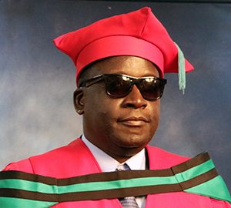
City Best Practices
Perspectives from Africa
AmaliTech is a social business and global talent accelerator providing IT-focused training and employment pathways and effective accessible online platforms for capacity building for disadvantaged youth in Africa.
It promotes inclusion and diversity and was commissioned by BMZ as a comprehensive intervention for job creation across the continent.
There are also many other platforms being set up as exchanges of experiences such as via WhatsApp groups, many of which also advocate on behalf of persons with disabilities. These platforms have huge potential for information exchanges (e.g. to address a problem in Mozambique for which a solution has already been found in West Africa.)
“The issue of COVID-19 within Africa has really impacted PWDs across the length and breadth of the continent. Within the context of PWDs, they become more vulnerable and exposed to the pandemic because of existing medical conditions. ”
Dr. Thomas Ongolo, Senior Disability Expert Adviser, Dept of Social Affairs, AUC

Slide 31
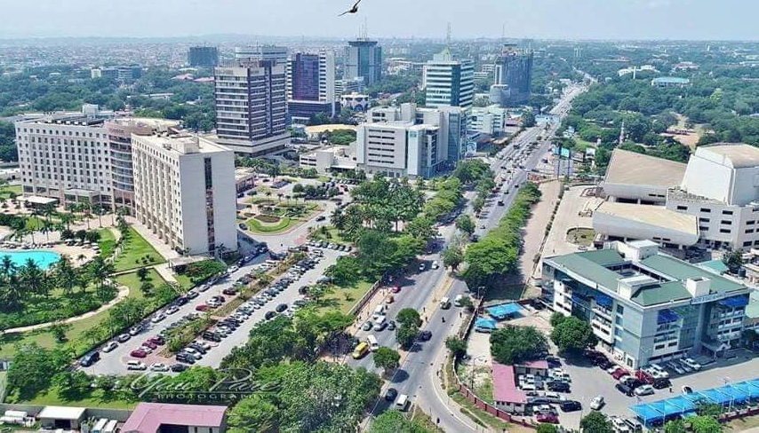
City Best Practices
Perspectives from Africa
In Ghana, AmaliTech Training Academy runs a fully accessible training centre where trainees participate in an intensive six month IT/digital training program.
Upon successful completion, trainees are offered employment pathways.
The program currently has 50 students who require home based learning structures. This is forcing trainers and trainees to use this online format, which is also helping to create new ideas and ways of thinking post-COVID.
“Lockdowns have quite dire impacts for them because when people are talking about an economic impact, the lockdown means a source of income has gone. For some this means we are talking about not having food. This is all about livelihood.”
Dr. Thomas Ongolo, Senior Disability Expert Adviser, Dept of Social Affairs, AUC

